Slide 1
Create a Simple Blog
John Jolley
Hanyu Liang

Slide 2
Solution: Making a Blog Using Firebase
Use Firebase to store information about blogs
Get the information from Firebase when we want info about he blogs
Used Javascript to get and retrieve the data

Slide 3
Pages: Home
Show all of the blogs and allow user to select a blog they wish to view
Somewhere they can click to sign up or log in
If user has an account and is logged in, then they can create a new blog

Slide 4
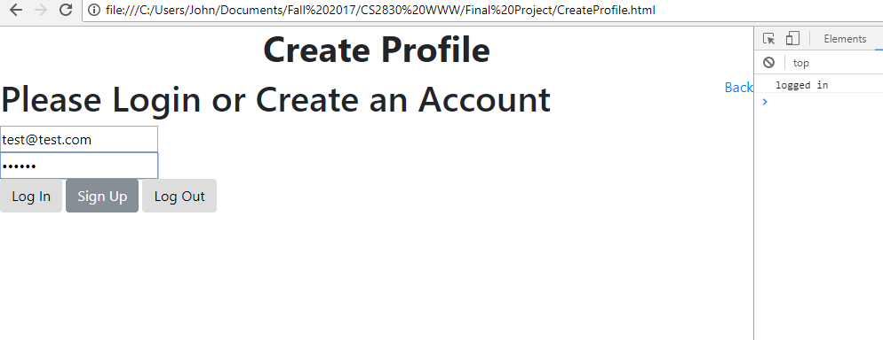
Log In or Sign Up
Users can create an account for themselves or log in

Slide 5
Create New Blog
Can only do it if you have an account and are logged in
Enter a Blog Title and put the text in

Slide 6
Show Blog
When a user selects a blog they want to see, the contents of the blog are displayed
Includes title, who made it and when, content, and comments associated with it.
If you have an account and are logged in, then you can post a comment

Slide 7
